Slide 1
Fetal Deaths, Authorized Person Cases, Disposition Permits, and Sub-Registrar Appointments
Melissa Boynton, MPH, Supervisor Electronic Data Solutions
Theresa Roberts, Supervisor and Deputy State Registrar

Slide 2
Agenda
Supplemental Certificate of Death
Fetal Deaths
Authorized Person cases/home funerals
Sub-registrar Appointments
Disposition permits
Authorization forms

Slide 3
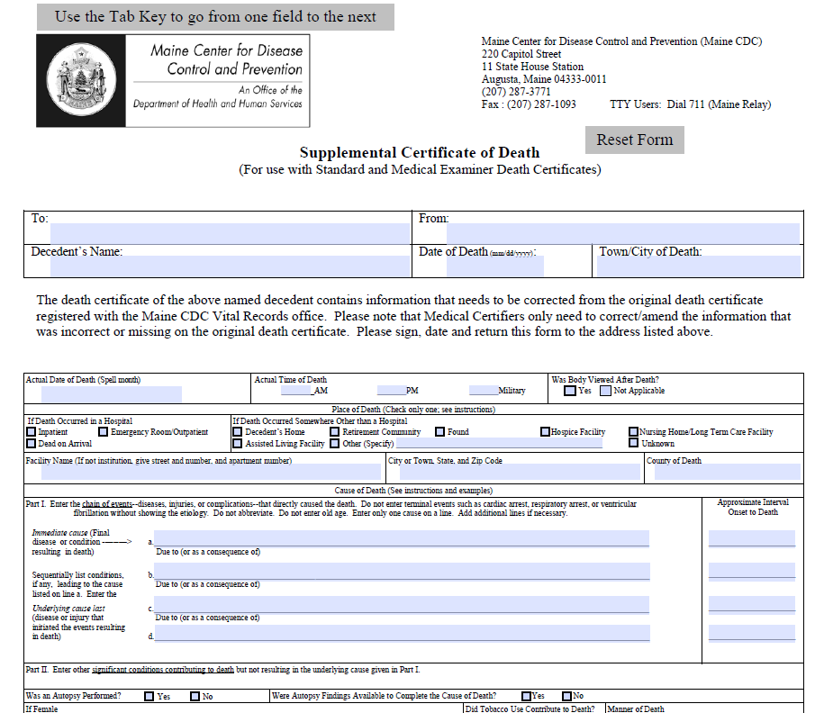
Supplemental Certificate of Death (SCOD)

Slide 4
Supplemental Certificates of Death (SCOD) are utilized when a Medical Certifier or the Medical Examiner needs to add or change information within the medical portion of the death certificate.
SCODs are now performed electronically through DAVE (2011-Present).
On paper records prior to DAVE, the record was marked with an asterisk (*) and marked “See Attached.” The paper SCOD with the changes was attached behind the record making the death record 2 pages. Paper deaths with SCODs attached should be issued on safety paper this way.
This page references pages 9, 14, and 41 of the death manual

Slide 5
Fetal Deaths
A fetal death is the death of a fetus 20 weeks gestation or greater.
Fetal deaths are only filed on a paper form furnished by the Department.
We are anticipating a new module within DAVE in 2024 for electronic filing.
The Certificate of Fetal Death (VS-4) was updated effective January 1, 2021 to be more user friendly and to add additional questions for statistical purposes.
Fetal deaths are processed by DRVS and a true copy attest is sent to the municipality of death only.
If you receive a certificate of fetal death from a funeral home, please forward to DRVS for registration.
This page references pages 41-42 of the death manual

Slide 6
Authorized Person Cases
An authorized person is someone who is acting in lieu of a funeral director and is handling final disposition on their own, which may be burial, cremation, or transportation out of state.
An authorized person can be a member of the immediate family of the deceased, the domestic partner of the deceased, or a person authorized in writing by a member of the immediate family of the deceased.
Do not panic
There are a few simple steps that need to take place to complete the death certificate and issue the disposition permit.
The following pages reference pages 37-39 of the handbook

Slide 7
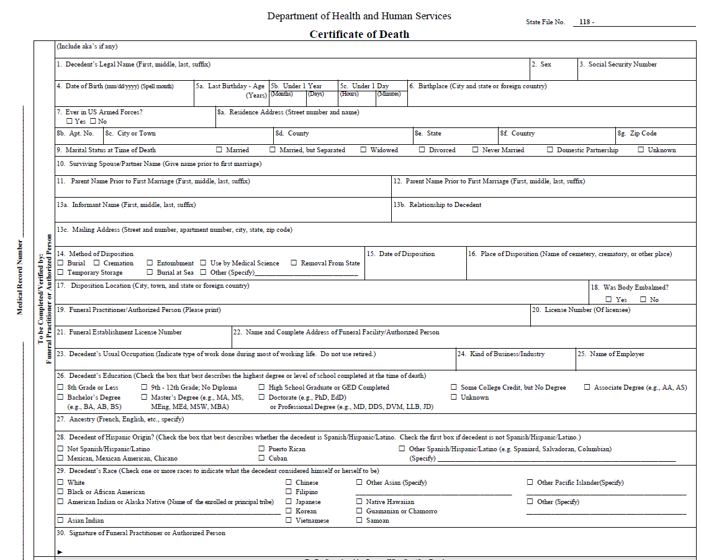
The Medical Certifier or Medical Examiner starts a case in DAVE, enters the medical information, and certifies the death case.
The Authorized Person will need to fill out items 1-30 on the paper death certificate (VS-3) and will sign on line 30.
The completed VS-3 may be scanned and attached to the case, emailed to Melissa Boynton, or faxed to the office. If you have a case or have attached the completed VS-3, please call Melissa Boynton at 287-5451 or email Melissa.Boynton@maine.gov.
The case is completed by the Department, registered, and assigned a State File Number (SFN).
A Disposition Permit may now be issued to the authorized person.

Slide 8
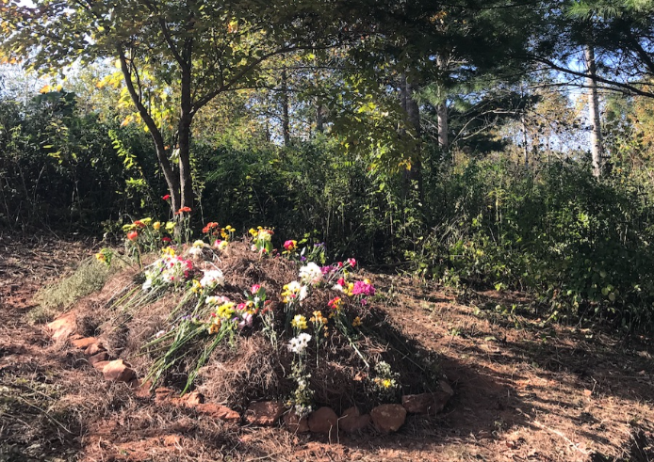
What if they want to bury on their property, is that legal?
Yes, home burials on private property are perfectly legal, as long as the property owner follows the proper procedures outlined in 13 MSR § 1142.
https://legislature.maine.gov/statutes/13/title13sec1142.html
https://www.maine.gov/dhhs/mecdc/environmental-health/plumb/burial/index.htm#BurialGrounds

Slide 9
Burying grounds are regulated by the Subsurface Wastewater Unit of the Department of Environmental Health

Slide 10
Sub-Registrars
The Department or a municipal clerk may appoint one or more suitable and proper persons in a municipality as sub-registrars, who are authorized to issue permits (Permits for Disposition of Human Remains, VS-35) for transportation and final disposition of dead human bodies.
There are two types of Sub-Registrars:
The annual appointment of a person residing or employed within the municipality, or
The annual appointment of a person who completes the application to become a State sub-registrar and who pays the $100.00 fee.
Both types of appointments entitle the appointed sub-registrar to issue a disposition permit upon a completed and signed death certificate and medical examiner’s release (if applicable). The municipality that appoints the sub-registrar collects the $20.00 fee if the place of death or establishment is located within their municipality (item #11b on the permit).
Sub-registrars may be appointed by both a municipality and the Department.
The following pages reference pages 32-34 of the death handbook

Slide 11
Sub-registrars must be appointed in writing, sworn in, and the annual appointment must be recorded in the office of the Department or the municipal clerk who appointed them. In the event a municipal clerk’s term has ended prior to the expiration date of the sub-registrar’s annual appointment, the sub-registrar must be reappointed. Municipal clerks may rescind a sub-registrar appointment at any time for any reason, although it is the responsibility of a municipal clerk to notify a sub-registrar in writing when the appointment has ended or been rescinded.
A permit may be issued by a sub-registrar only when the municipal office is closed, or the municipal clerk or deputy clerk is not available. Sub-registrars must scan and attach the completed disposition permit, after endorsement, to the death case in the Electronic Death Registration System (EDRS)

Slide 12
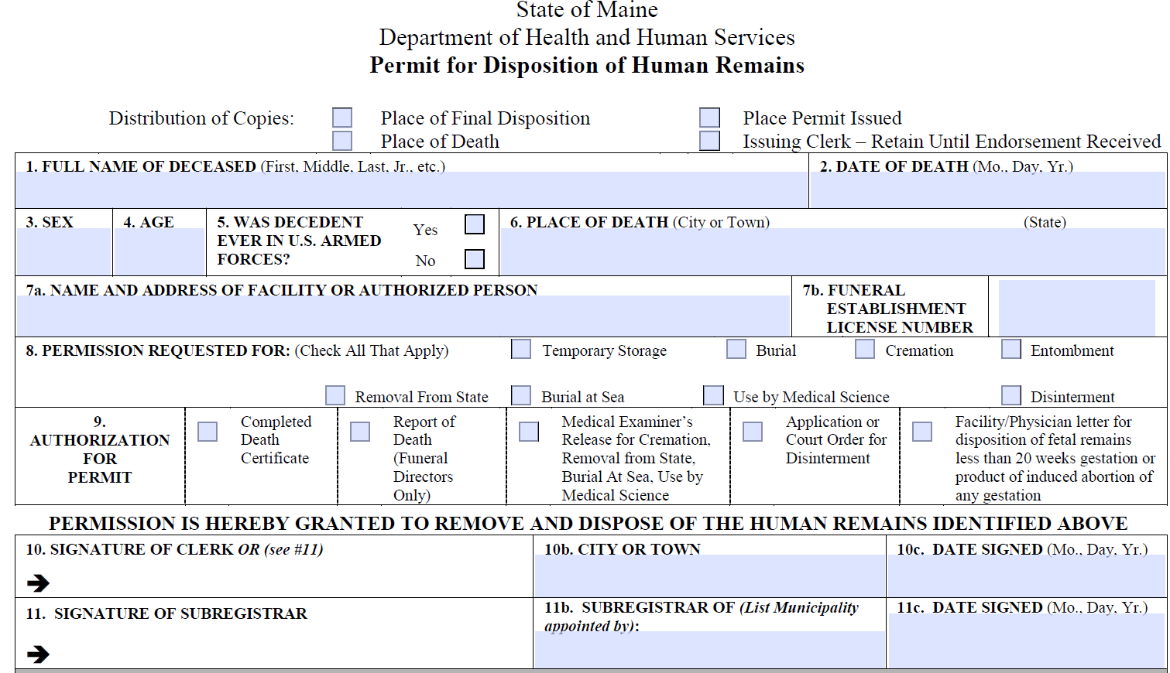

Slide 13
Subregistrars can not issue a disposition permit for the disinterment of a body!

Slide 14
Disposition Types and ME Releases
A “method of disposition” must be checked on the death certificate. This will determine if a medical examiner’s release form (VS-37) is needed to accompany the completed death certificate or report of death prior to issuing a disposition permit.
Methods of disposition that do not require a medical release are temporary storage and burial.
Methods of disposition that require a medical examiner’s release include cremation, burial at sea, use by medical science, and removal from state. A copy of the signed medical examiner’s release must be retained permanently by the municipal clerk who issues the disposition permit. If the death is electronic (2011 to present), the medical examiner’s release form may be scanned and attached to the death case in the Electronic Death Registration System (EDRS).
Funeral Directors may request and file the medical examiner’s release electronically. If they do not, and opt to do a paper copy, a red “M.E. Release Required” status will show in the status bar. This does not impact your ability to issue certified copies. See screenshot below:
The following pages reference pages 22-32 in the death handbook

Slide 15
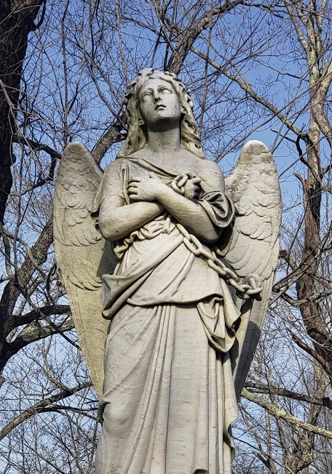
Disposition Permits
The municipality listed in 10b or 11b on the Disposition Permit collects the $20.00 issuing fee (see below).
The issuing clerk or sub-registrar cannot sign as person in charge of final disposition on the disposition permit unless the remains were placed in temporary storage and the funeral director owns the storage facility specified.
The place of death municipality, the place the permit issued municipality and/or the Department, and place of final disposition municipality is where the endorsed disposition permit is filed (unless scanned and attached in the EDRS).
Deaths occurring at the United States Department of Veteran’s Affairs (also known as Togus) are filed directly with the Department and the disposition permit must be issued by the Department or an appointed sub-registrar of the Department. The Department collects the $25.00 issuing fee.
NEW: LD465 Allows for an electronic disposition process. As this requires updates to the system, this is not yet live. Training on this will be forthcoming. This law also repeals the requirement for the VS50.

Slide 16
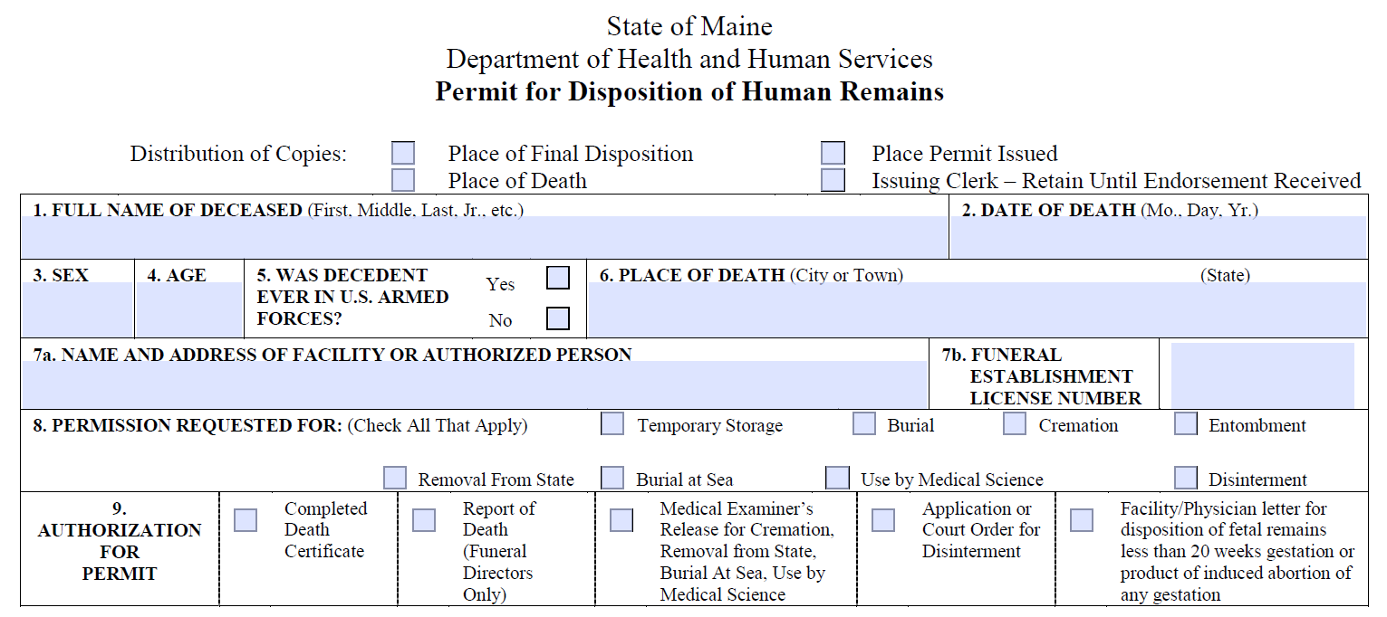
Permits for Fetal Deaths and Miscarriages
When issuing a disposition permit for a fetal death (20 weeks or greater) the funeral director or authorized person must present the completed certificate of fetal death and ME Release (if applicable)
If the permit is for a miscarriage (20 weeks or less), the funeral director or authorized person must present a letter from the medical facility stating the fact of miscarriage, the funeral home or person the remains are being released to, and signature from the health care professional. A ME Release is not required for miscarried remains that are being cremated or removed from state.
This page references pages 42-46 of the death manual

Slide 17
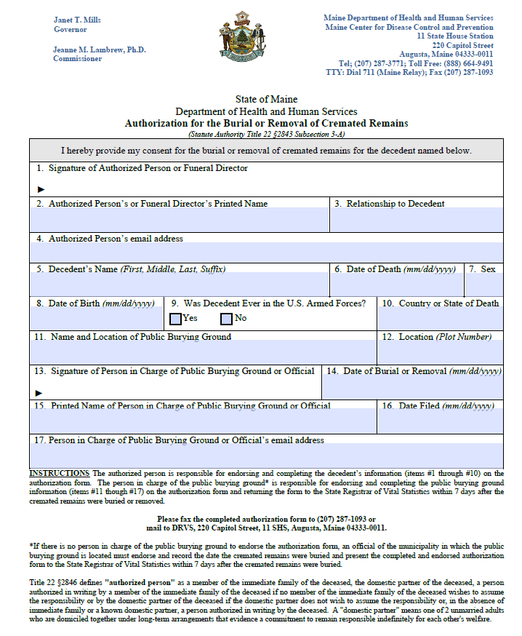
Authorization Forms (VS50)
The Authorization for Burial or Removal of Cremated Remains Form (VS50) was created to track the burial of cremated remains buried in public burying grounds
Despite the requirement to report these burials, this did not work as intended and was under-reported
LD 465 Repeals the requirement for the VS-50 (they are now voluntary) and the information gathered will be integrated into the electronic disposition permit which is forthcoming. If you receive completed VS-50s in your municipality, you may still forward them to DRVS for filing.
This page references pages 35-36 of the death manual

Slide 18
Additional Resources
Maine Funeral Consumer’s Alliance https://www.fcamaine.net/
Order of the Good Death https://www.orderofthegooddeath.com/
Last Things: Maine’s Home Funeral Resource https://www.lastthings.net/

Slide 19
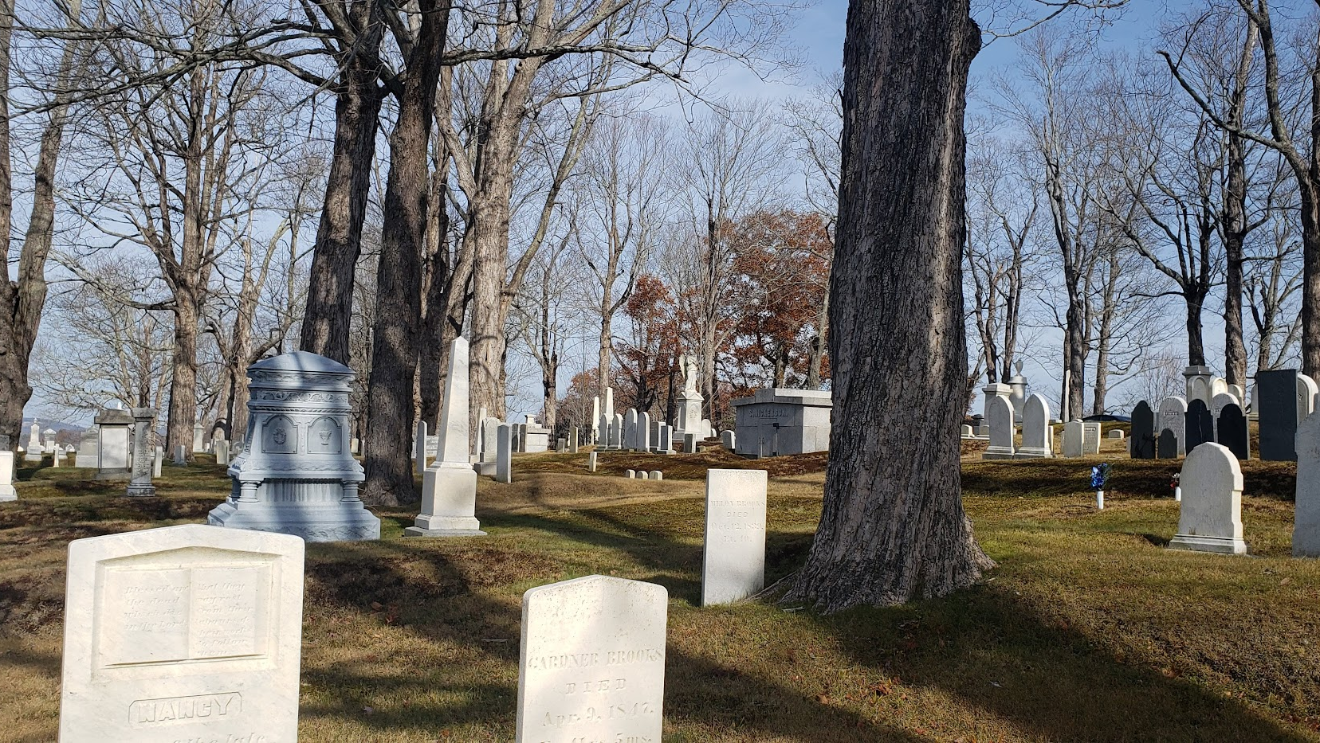
Questions?

